Slide 1
OpenWERX
Inaugural Challenge: 21st Century "Jed Set"

Slide 2
OpenWERX Challenge: Guiding Principles
Open
Use Open Source/Open Hardware/Creative Commons building blocks
All new development (hardware, electronics, software) must be publicly and freely available under an appropriate Open Source license before judging begins
Collaborative
Build a team
Engage the broader open development ecosystem
Join the OpenWERX Slack channel: https://suncoast-devs.slack.com/messages/openwerx/

Slide 3
OpenWERX Challenge: Parameters
Register To Compete
OpenWERX Event Page
NLT 13 September 2016
Demonstrate Work
In Person
7 October
5-10 minutes per team
Judging/Awards
Immediately following demonstrations
Cash prizes: $3k (1st place), $2k (2nd place), $1k (3rd place)

Slide 4
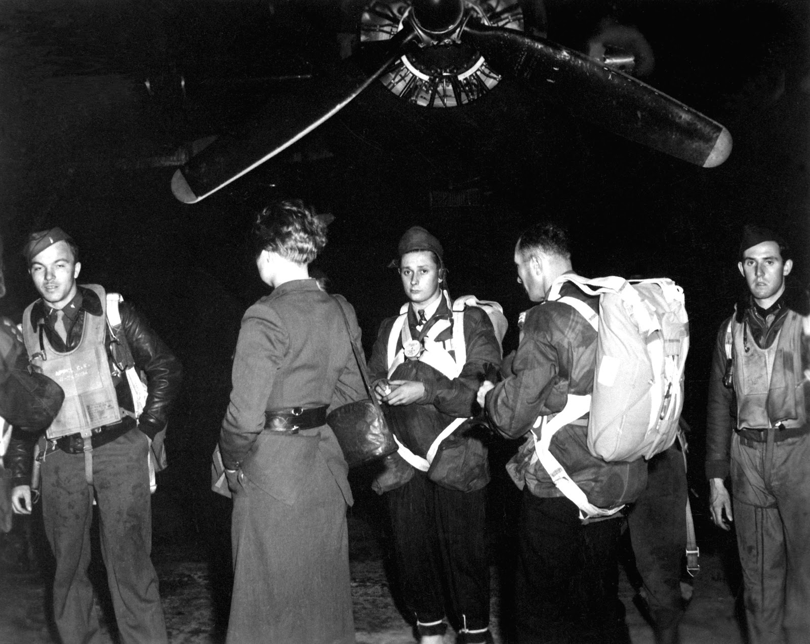
Operation Jedburgh

Slide 5
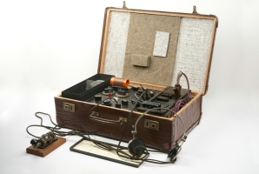
Type 3 Mk. II "Jed Set"

Slide 6
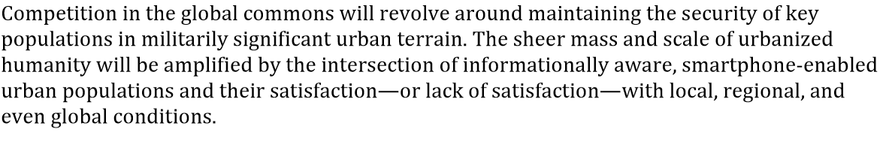
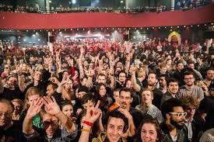
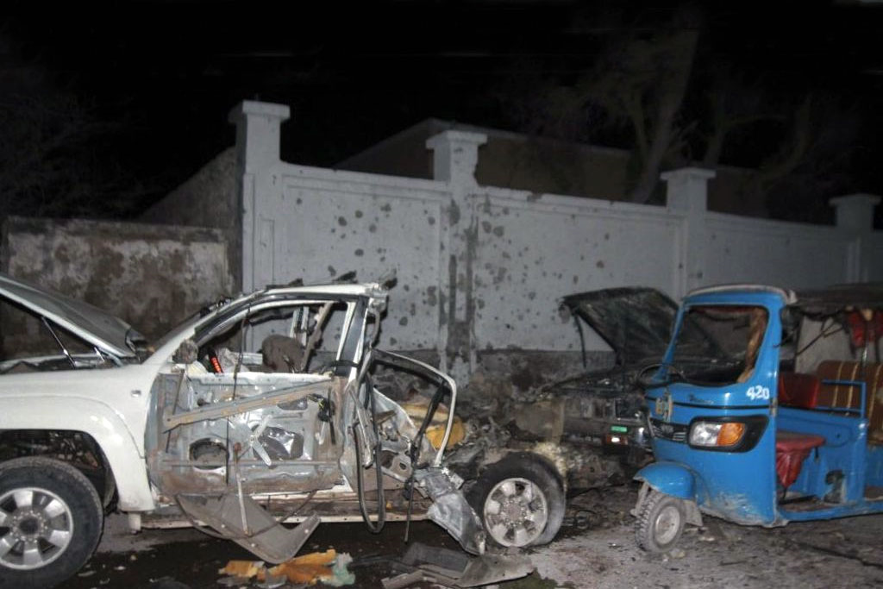
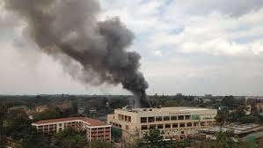
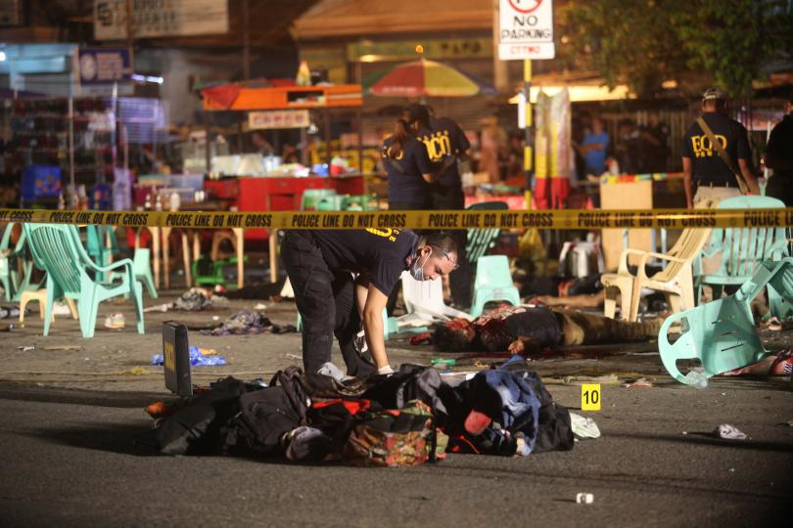
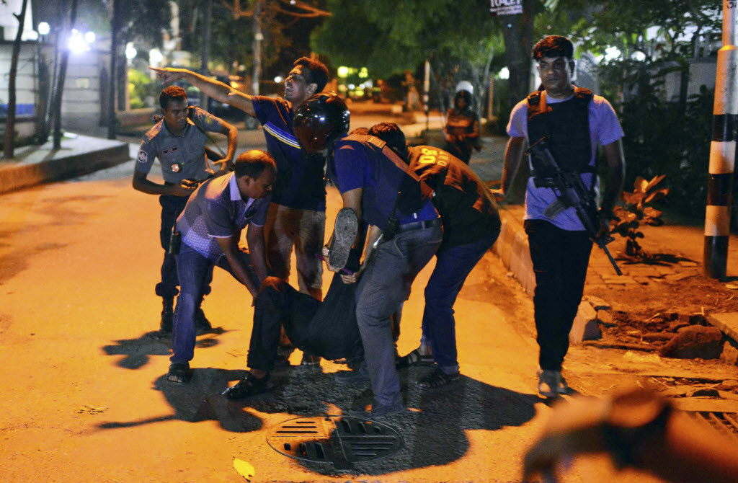
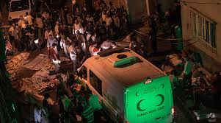
Today's Battlefield
Notes:
Clockwise from TL:
1. Kenya Mall Attack
2. Paris Theatre Attack
3. Somali Hotel Attack
4. Bangladesh Café Attack
5. Turkish Wedding Attack
6. Philippine Restaurant Attack

Slide 7
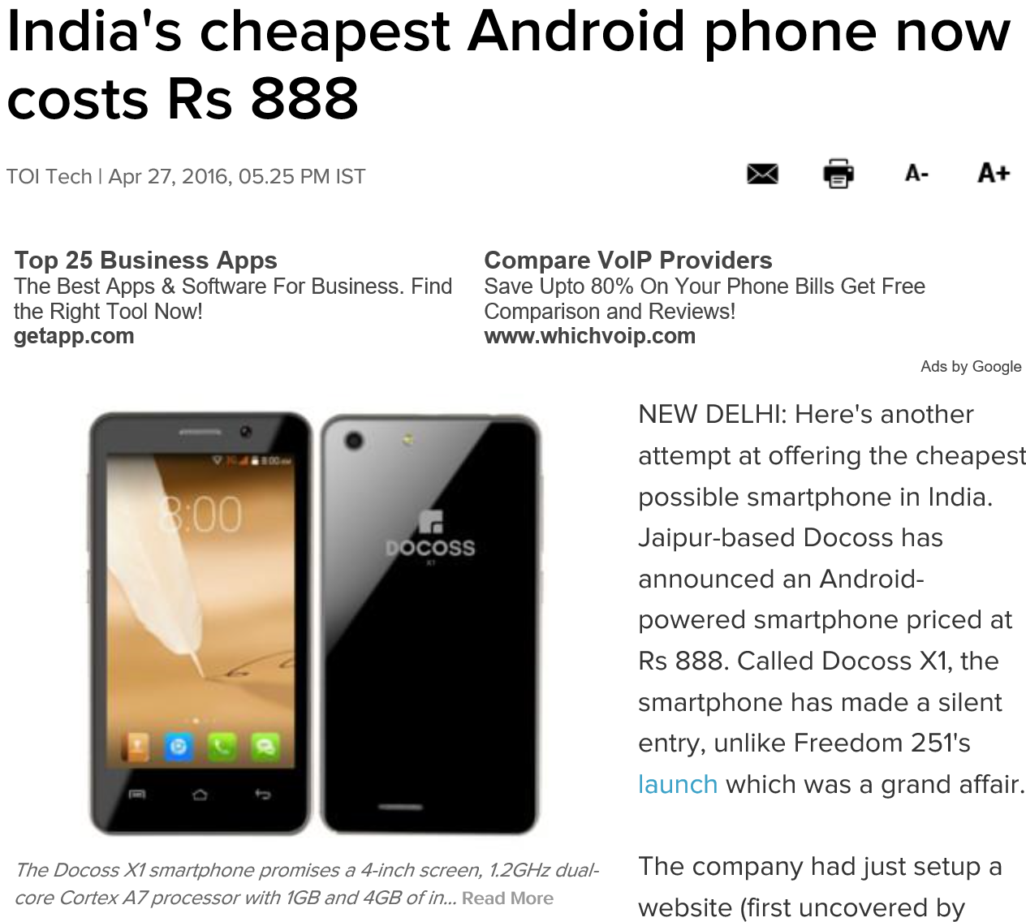
Today's Communications

Slide 8
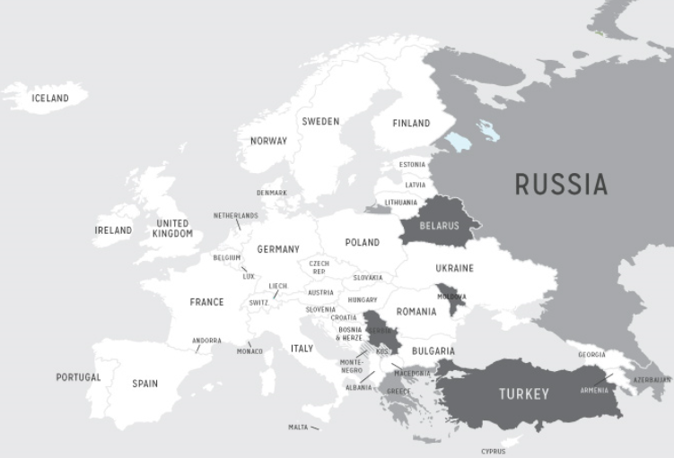
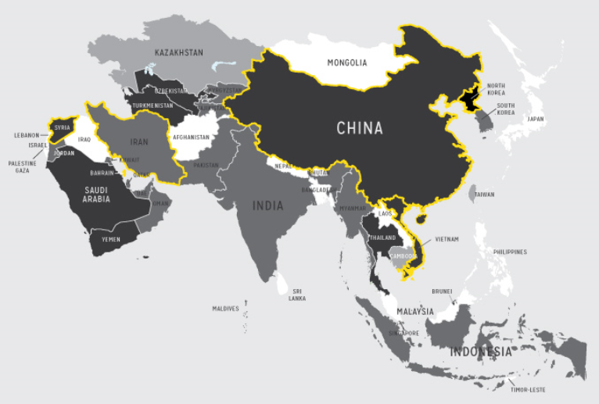
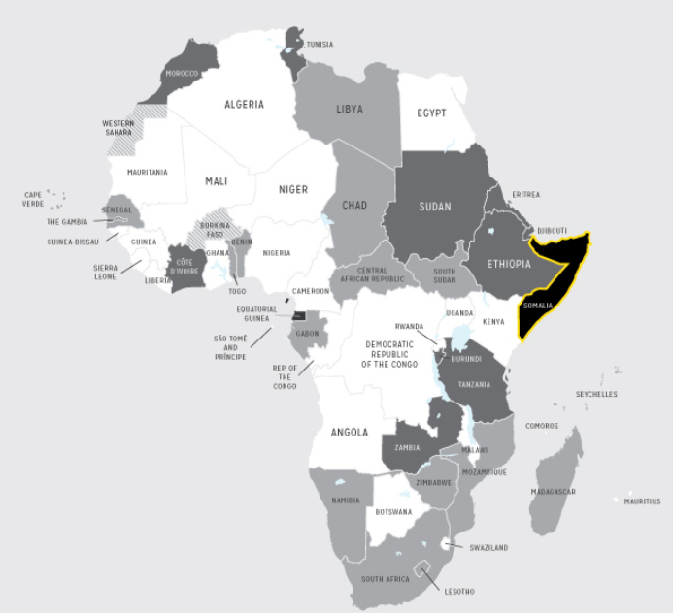
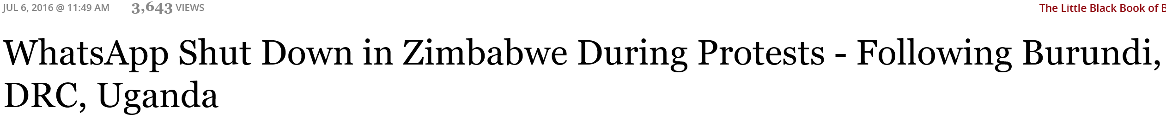
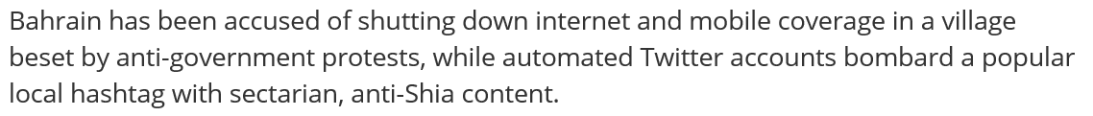
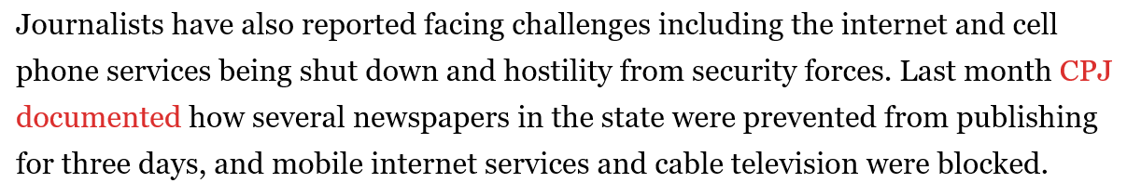
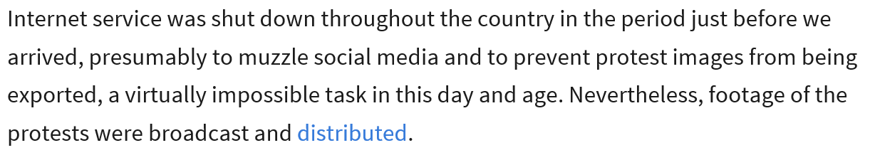
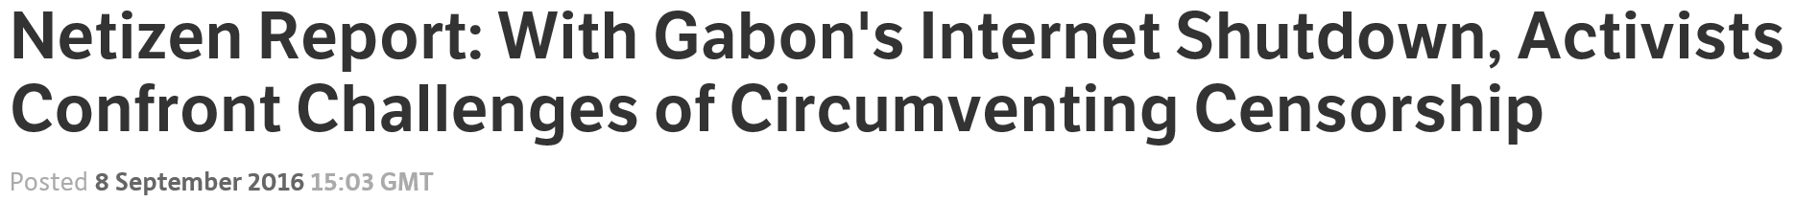
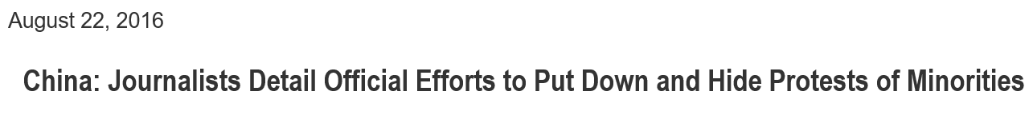
Except...

Slide 9

Why It Matters.1
Notes:
https://en.wikipedia.org/wiki/De_oppresso_liber

Slide 10
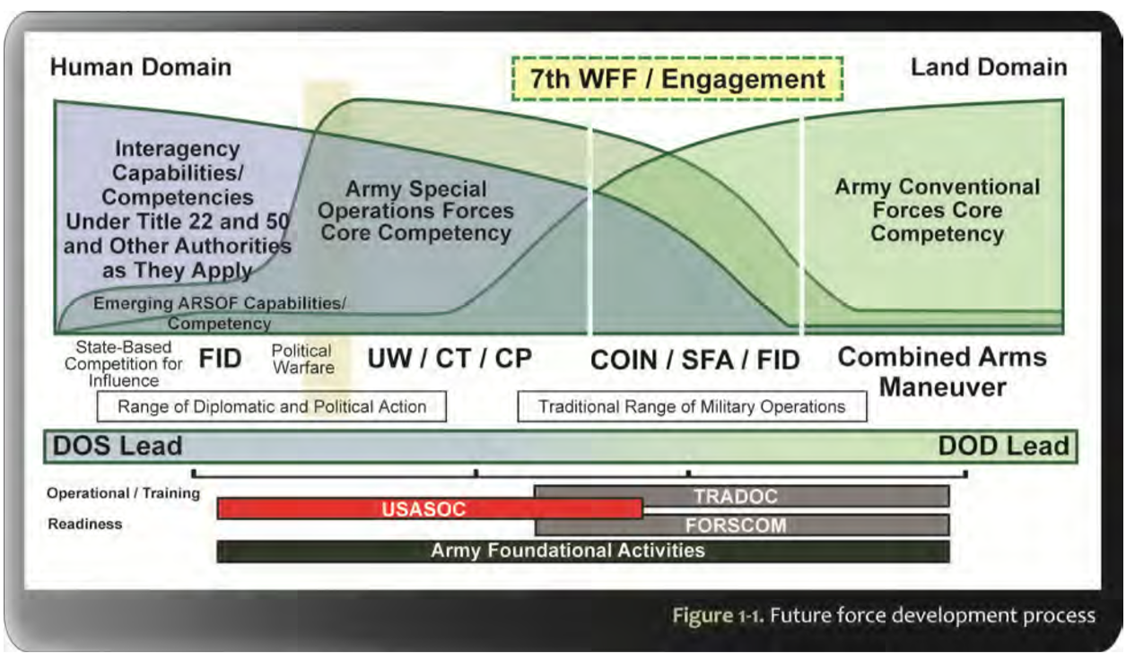
Why It Matters.2
Notes:
http://www.soc.mil/Assorted%20Pages/ARSOF%20Operating%20Concept%202014.pdf
ARSOF Operating Concept 2020

Slide 11
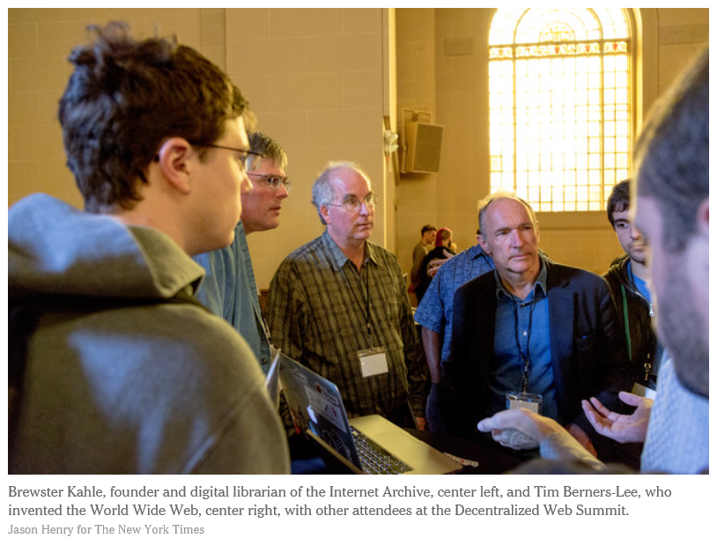
Help Is On The Way

Slide 12
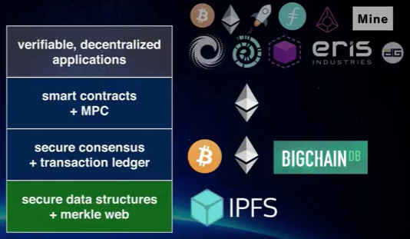
What Has Been Done?

Slide 13
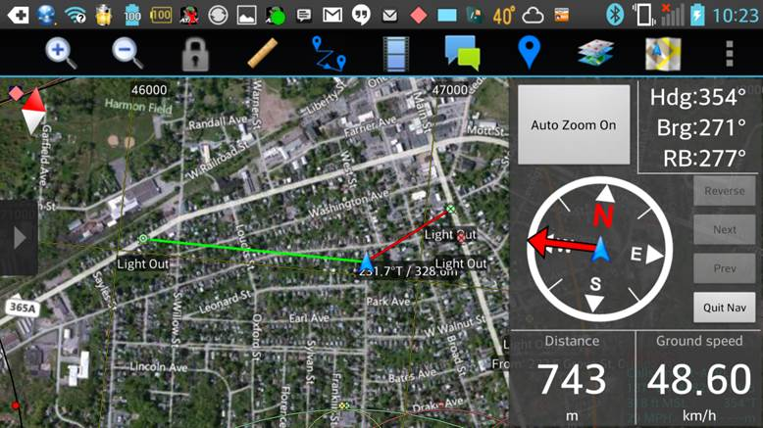
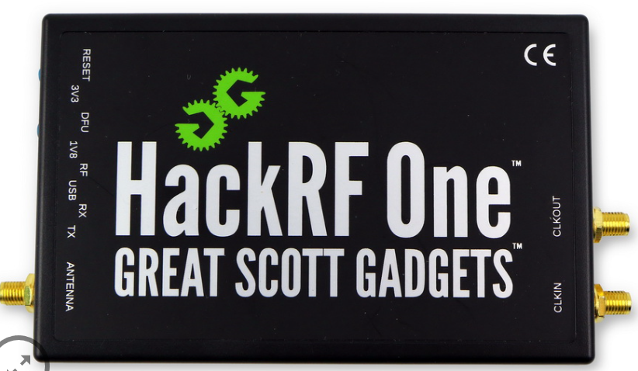
OpenWERX Challenge: Build The New Jed Set

Slide 14
Specifics.1
Threshold Goal: Moving Map
Build a mobile-compliant (web, hybrid, and/or native) map application
User must also be able to interact with the map when disconnected (e.g., local caching of all data) to support personal navigation.
Map shows all Jed Box user locations when connected to a mesh network via the SDR

Slide 15
Specifics.2
Threshold Goal: Support A Complete P2P Data Transfer Stack
All data communications must use distributed, peer-to-peer technologies to the extent possible. Possible candidate technologies include:
Ipfs
Ethereum
Zeronet
WebRTC
P2P OpenStreetMap Database: https://github.com/digidem/osm-p2p-db
Peergos: https://github.com/Peergos/Peergos/blob/master/README.md

Slide 16
Specifics.3
Threshold Goal: Build Android/SDR Data Interoperability
Extend the moving maps app to display data received by a Software Defined Radio. Possible components include:
RTL2832U Dongle: http://www.ebay.com/sch/i.html?_from=R40&_sacat=0&_nkw=RTL2832U&_sop=15
Android rtl-tcp protocol driver: https://github.com/martinmarinov/rtl_tcp_andro-
USB OTG cable
RFAnalyzer: https://github.com/demantz/RFAnalyzer
Android GNURadio: http://gnuradio.org/redmine/projects/gnuradio/wiki/Android
Android GNURadio Template: https://github.com/trondeau/GrTemplate

Slide 17
Specifics.4
Threshold Goal: Build Android/SDR Physical Integration
Build a cell phone case that houses the SDR in the least obtrusive/obvious way possible. Approaches include:
Additive (3D printing/sintering)
Subtractive (CNC Routing)
Moulding
Handcrafted

Slide 18
Specifics.5
Reach Goals:
Add video/voice/text chat to app
Add p2p encryption (one-on-one/group) to the data stack
Add anonimization to the data stack
Use a SDR transceiver (HackRF, BladeRF, etc) to transmit position, video, voice and/or text data to other Jed Box users
Spin an integrated circuit board that includes the SDR, duplexer, amplifier, and antenna. Integrate the board into a cell phone case.

Slide 19
Beyond Here Be Dragons (Backup Slides and References)

Slide 20
References
The Mission to Upgrade the Internet: https://www.youtube.com/watch?v=Vs3l2_Th4q0
IPFS Slide Show: http://www.slideshare.net/DavidDias11/rdm2-the-distributed-web
ZeroNet Presentation: http://zeronet.io/files/ZeroNet_Presentation.pdf

Slide 21
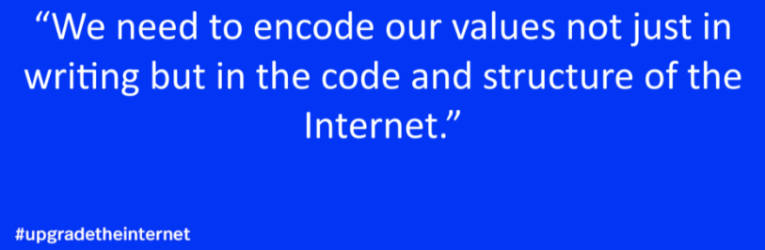
#upgradetheinternet

